Slide 1

Clustering Methods
Zakariya Abu Grin, Viktor-Johannes Holl, Loa Marx, Ananya Neogi, Lenka Ting
Master in Applied Data Science
Oktober 10, 2019

Slide 2
Overview
Introduction of 5 types of clustering methods
Partition Clustering
Model-based Clustering
Density-Based Clustering
Fuzzy Clustering
Hierarchical Clustering
Summarized Comparison

Slide 3
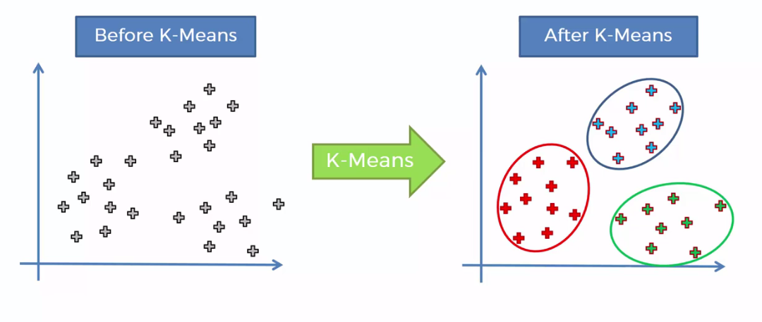
Partition Clustering
Partitioning algorithms are clustering techniques that subdivide the data sets into a set of k groups, where k is the number of groups pre-specified.
Examples: k-means, k-mediods clustering or PAM(Partitioning Around Medoids), Clara Algorithm.
Notes:
The optimal number of “k” clusters are to be identified and determined based on the problem statement.
Division of data objects into subsets (clusters) such that each data object is in exactly one subset.
These algorithms are generally sensitive to outliers, which is a limitation to be paid heed to in implementation.
Few examples of these kind of clustering algorithms:
k-means.
k-mediods clustering or PAM(Partitioning Around Medoids, Kaufman & Rousseeuw, 1990): in which, each cluster is represented by one of the objects in the cluster. PAM is less sensitive to outliers compared to k-means.In k-medoids clustering, each cluster is represented by one of the data point in the cluster. These points are named cluster medoids.
Pros: it’s intuitive, more robust to noise and outliers compared to k-means, and it produces a “typical individual” for each cluster (useful for interpretation).
Cons: it’s time consuming and computer intensive.
CLARA algorithm (Clustering Large Applications), which is an extension to PAM adapted for large data sets;in order to reduce computation time and overcome RAM storage issues.

Slide 4
Model-based Clustering
Approach:
A probabilistic approach where data is assumed to be generated from some mixture of probability distributions.
Outcome:
The probability of each point data point belonging to each cluster.
Data points are assigned based on the highest probability (Soft Clustering) or by 0 and 1 probability based on some rule/boundary (Hard Clustering).
Reference: “Bayesian Analysis with Python”

Slide 5
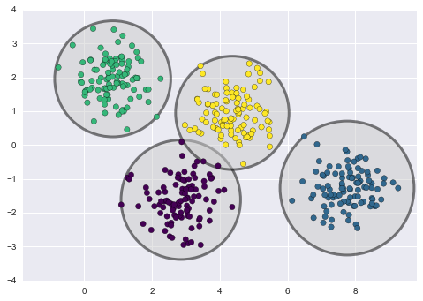
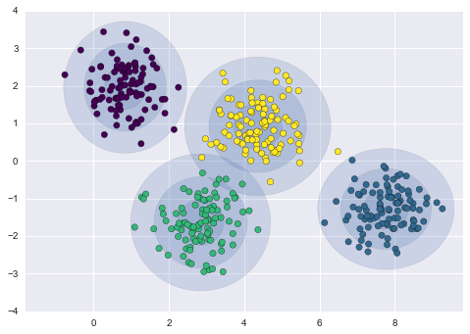
Model-based Clustering
K-means Gaussian Mixture Models (GMMs)
Reference: Python Data Science Handbook

Slide 6
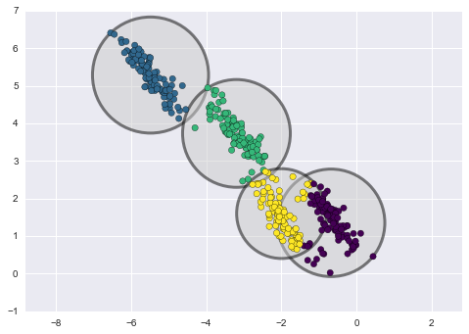
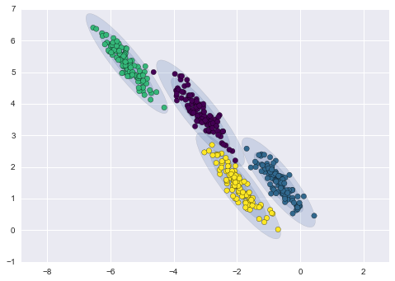
Model-based Clustering
K-means Gaussian Mixture Models (GMMs)
Reference: Python Data Science Handbook
Reference: Python Data Science Handbook

Slide 7
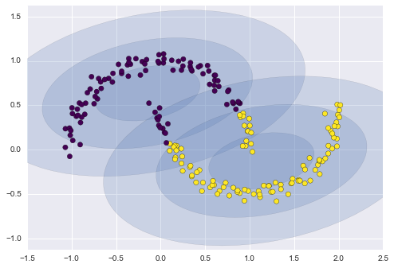
Model-based Clustering
Gaussian Mixture Models (GMMs)
Reference: Python Data Science Handbook

Slide 8
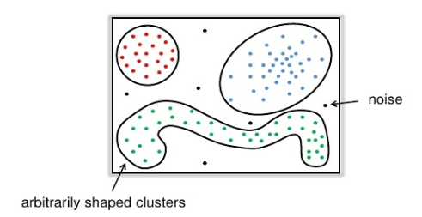
Density-Based Clustering
Identify distinctive groups/clusters in a data set, based on the idea that a cluster in a data space is a continuous region of high point density, separated from other such clusters by contiguous regions of low point density
Based on connectivity and density functions
Locates regions of high density that are separated from one another by regions of low density
Two parameters:
1. maximum radius of the neighbourhood→Eps
2. minimum number of points in the Eps neighbourhood of a point→MinPts
Pros:
Is great at separating clusters of high density
from clusters of low density within a given dataset
Is great with handling outliers within the dataset
Cons:
struggles with clusters of similar density
Sensitive to the settings of parameters

Slide 9
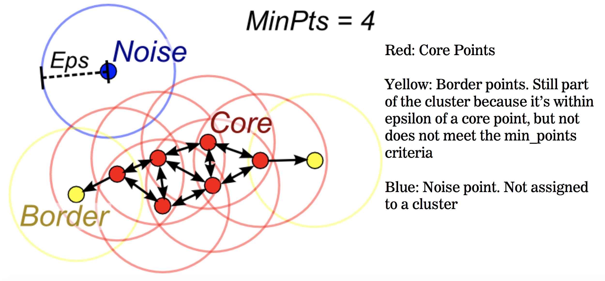
Density-Based Clustering
DBSCAN (Density-Based Spatial Clustering of Applications with Noise)
Algorithm:
Arbitrarily select a point p
Retrieve all points density-reachable from p w.r.t. Eps and MinPts
If p is a core point, a cluster is formed
If p is a border point, no points are density-reachable from p, and DBSCAN goes to the next point of the dataset
Continue the process until all of the points have been processed
Visualization Example
https://www.youtube.com/watch?v=h53WMIImUuc
Notes:
Hiiiiiiiiii Johannes

Slide 10
Fuzzy Clustering
Soft Method
An item can be part of more than one cluster
Each has a set of membership coefficients corresponding to the degree of being in a given cluster.

Slide 11
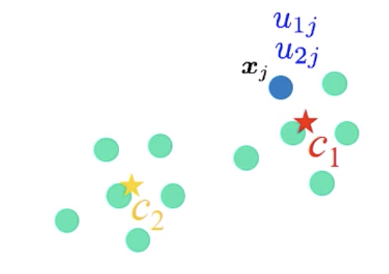
Fuzzy C-means
The centroid of a cluster is calculated as the mean of all points, weighted by their degree of belonging to the cluster.
Data points close to center of a cluster -> get higher degree (total membership for a point must add to 1)
u1j + u2j =1

Slide 12
Fuzzy C-means steps
Specify k (number of clusters) and m.
Assign randomly to each point coefficients for being in the clusters.
Repeat the followings until (i) we reach the max number of iterations (ii) the algorithm has converged.
a. Compute the centroid for each cluster.
b. For each point, compute its coefficients of being in the clusters.

Slide 13
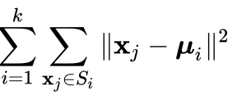
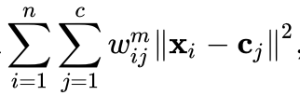
Brief Comparison
 | K-means | Fuzzy C-means
Calculation Speed | Fair | Low
Function
Implementation | Traditional case/ Limited | Can handle uncertainty Can be used in variety of clusters
Notes:
fcm - full inverse-distance weightings
M - determines the level of cluster fuzziness. A large M results in smaller membership values

Slide 14
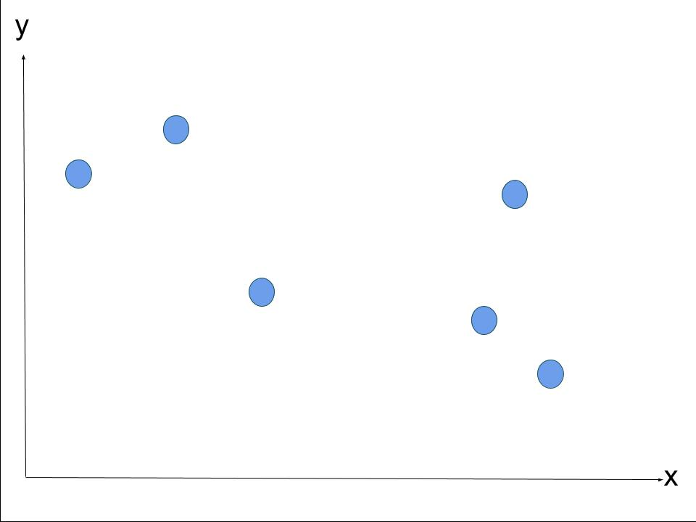
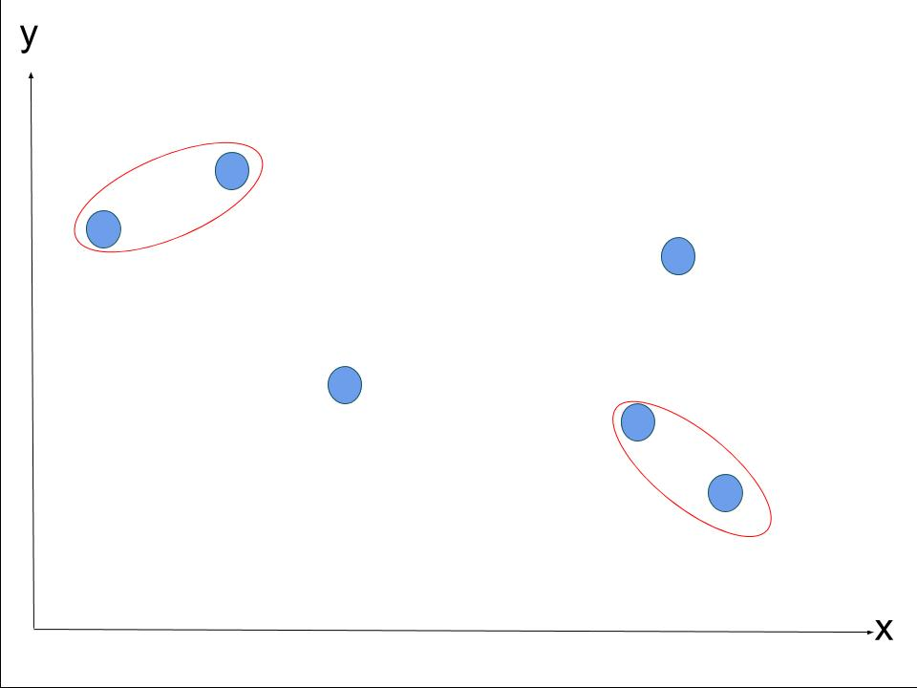
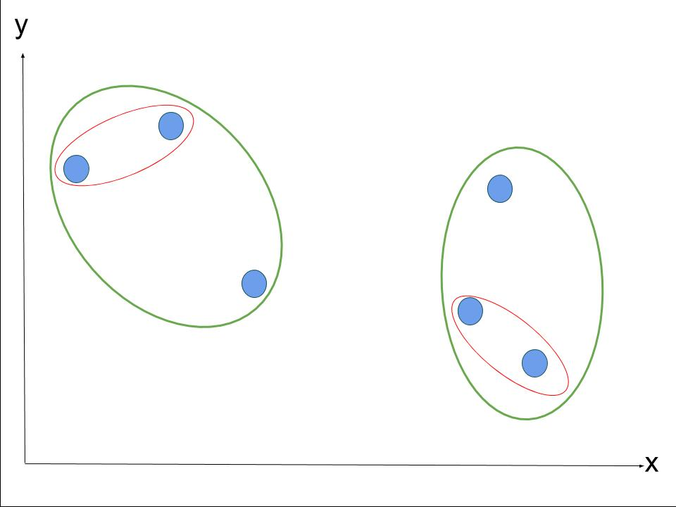
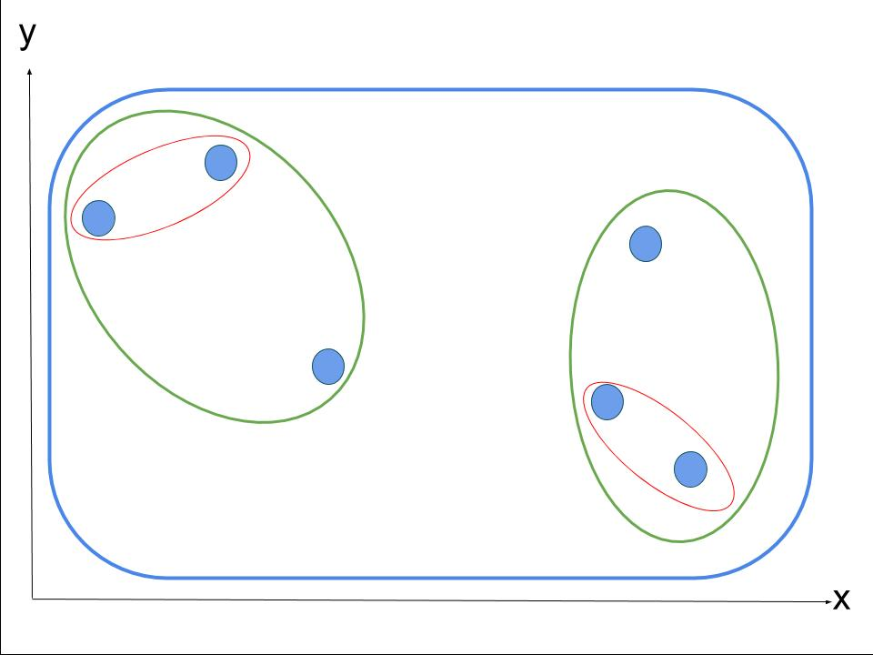
Hierarchical Clustering
Each node is its own cluster
Clusters merge together by minimally increasing the linkage distance
Advantages:
No need to specify “k” clusters
Produces different levels of resolution
Flexible regarding the metric used for merging
Disadvantages:
Time efficiency is not optimal
Suited for smaller datasets
Decide which level of resolution is sensible

Slide 15
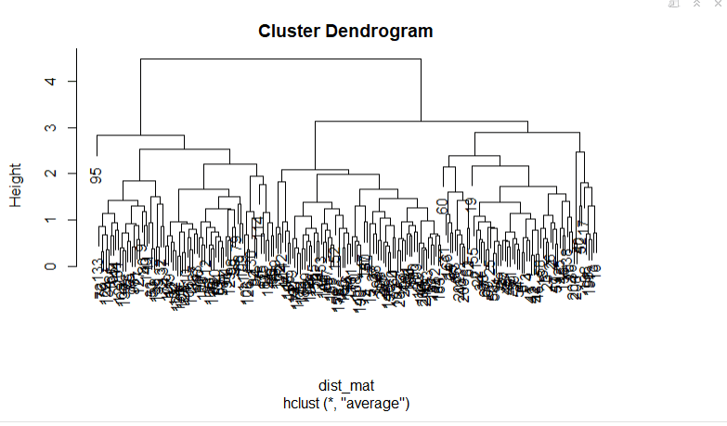
Hierarchical Clustering with a big dataset

Slide 16
Comparative Study of the Clustering methods
 | Partition | Hierarchical | Fuzzy | Model-based | Density-based
Core Concept | Datapoints are assigned to moving centroids | Datapoints are merged according to distance | Datapoints have multiple weighted memberships | Datapoints are assumed to belong to some distributions | Identify distinctive groups/clusters in a dataset
Advantages | - No overlap between the clusters - Good computational performance | - No specification of “k” | More applicable and robust | One of the fastest | - Separating clusters of high density - Handling outliers within the dataset
Limitations | - Sensitive to outliers - “k” must be specified | - Computationally expensive - Suited for small datasets | - Computationally expensive - Result depends on the initial choice of weights | Suffers with non-gaussian distributed data | Struggles with clusters of similiar density
Hard/Soft Clustering | Hard | Hard | Soft | Soft | Soft
Algorithms | k-means, Clara, k-mediods (PAM) | AggloC | Fuzzy C-Means | Gaussian Mixture Models | -DBSCAN

Slide 18
References
https://hdbscan.readthedocs.io/en/latest/comparing_clustering_algorithms.html
https://www.datanovia.com/en/blog/types-of-clustering-methods-overview-and-quick-start-r-code/#partitioning-clustering
https://www.datanovia.com/en/courses/partitional-clustering-in-r-the-essentials/
https://medium.com/predict/three-popular-clustering-methods-and-when-to-use-each-4227c80ba2b6
https://ethz.ch/content/dam/ethz/special-interest/gess/computational-social-science-dam/documents/education/Spring2015/datascience/clustering2.pdf
https://medium.com/@elutins/dbscan-what-is-it-when-to-use-it-how-to-use-it-8bd506293818
https://elementtechnologies.net/life-sciences-services/clinical-data-services

Slide 19
Affinity Propagation
Main Characteristics:
Graph based approach.
Unlike K-means, the user doesn’t need to specify the number of clusters.
Parameters:
Preference
Damping factor

Slide 20
Affinity Propagation
Reference:
https://hdbscan.readthedocs.io/en/latest/comparing_clustering_algorithms.html

Slide 21
Overview
Guidance for slides:
add Resources to the last slide
Slides should contain the main idea behind the method and pros/ cons
Final presentation: ~15:45
Think of columns for the final comparison table (e.g. time/ computing efficiency, suited for which data…)

